Slide 1
Present by
Sasitorn Chen
Python for Data Analytics
DATA201
Capstone Project
Animal Shelter

Slide 2


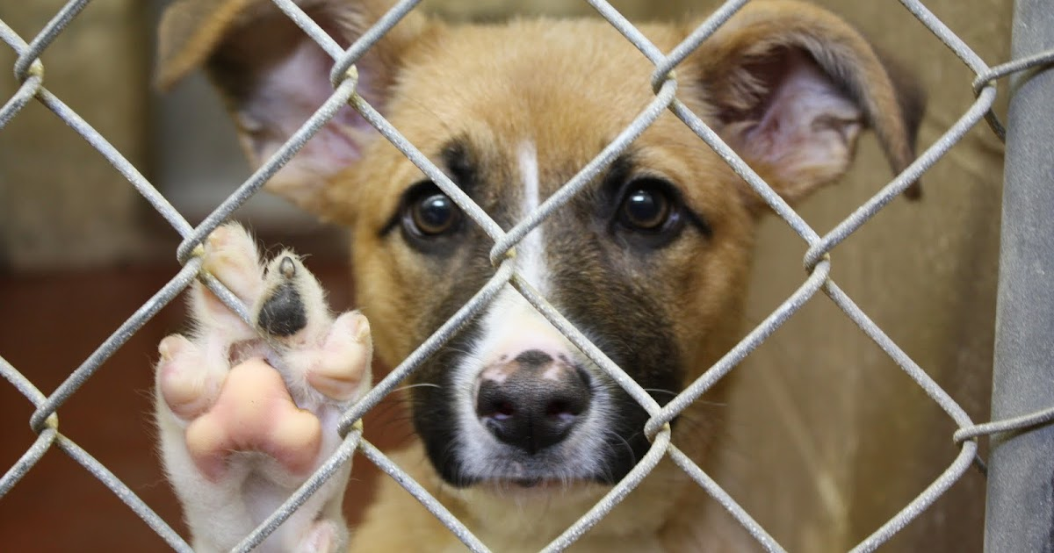
Austin Animal Center
Animal protection and provides shelter to more than 16,000 animals annually.
Accept stray and owned animals regardless of age, health, species or breed.
Finding the forever homes through adoption for animal.
Lost and Found.
Reference Data Source: https://www.kaggle.com/jackdaoud/datasets

Slide 3
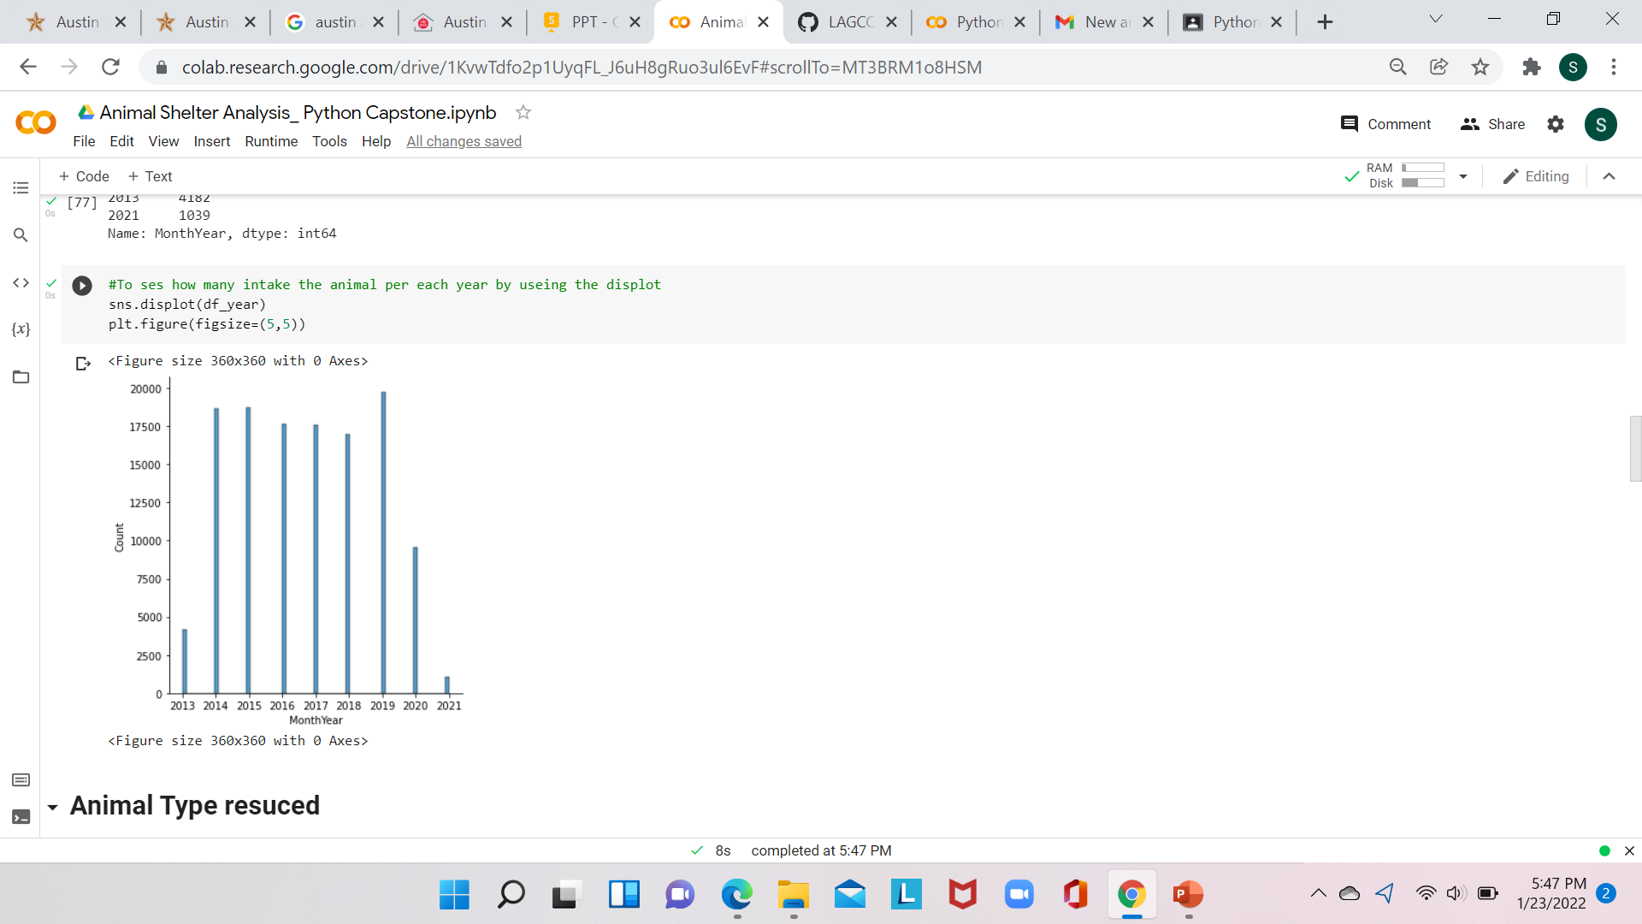
Animal Accepted to the Shelter Each Year
19728
The total animals intake was 124,000 from 2013 to 2021
46%
Notes:
2019 19728
2015 18712
2014 18656
2016 17675
2017 17563
2018 16979
2020 9586
2013 4182
2021 1039

Slide 4
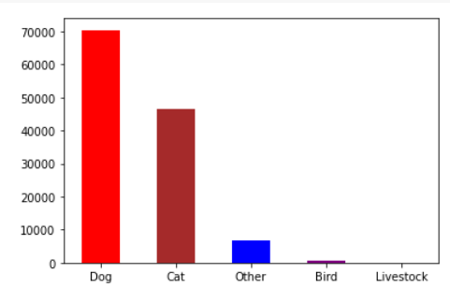
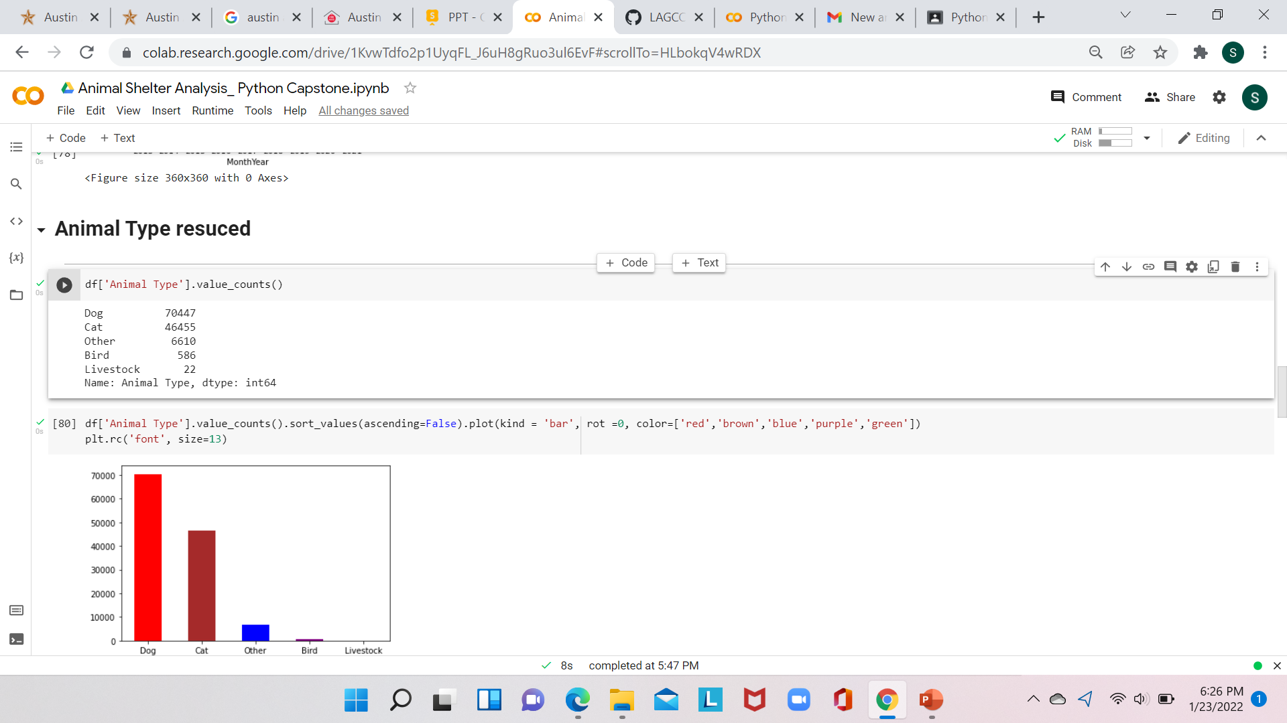
Animal Types in the Shelter

Slide 5
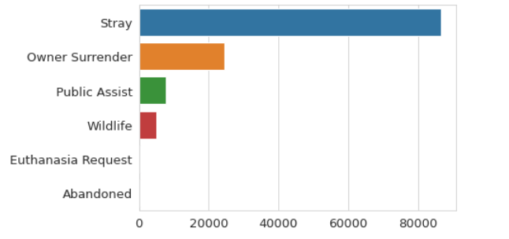
Cause of Animal Intake to the Shelter
86455
24606
7621
4898
283
257

Slide 6
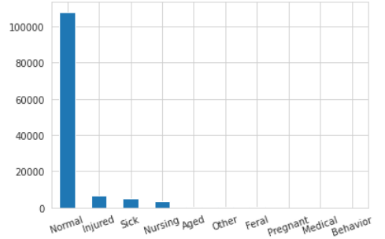
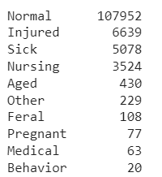
Type of Condition when Came in to the Shelter
87%

Slide 7
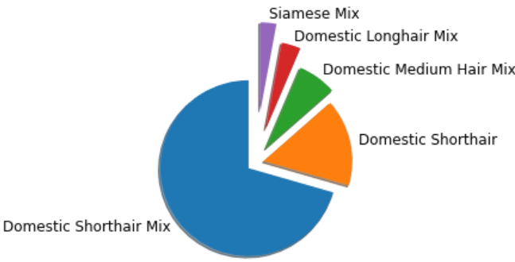
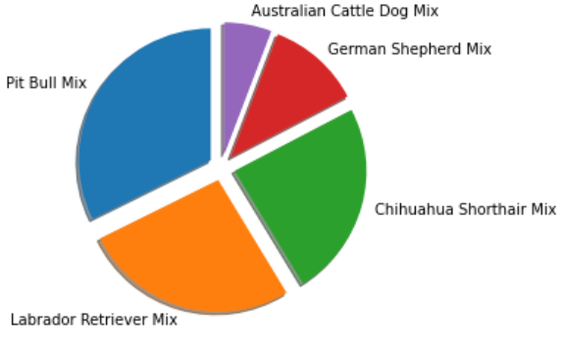
Top 5 Breed Dog and Cat in the Shelter
Dog
Cat

Slide 8
Conclusion
From year 2019 to 2021, the shelter intake of animals decreased by 46 percentage.
Stray animal and owner surrender are the top reasons the animals stay in the shelter.
87% of animals are normal and healthy and 30% of other conditions which include sick, injured, and behavior.

Slide 9
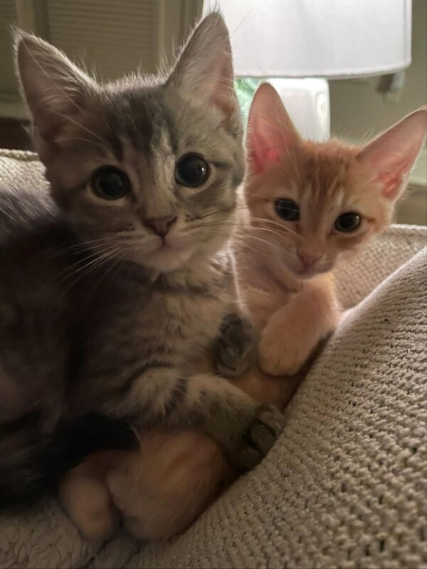
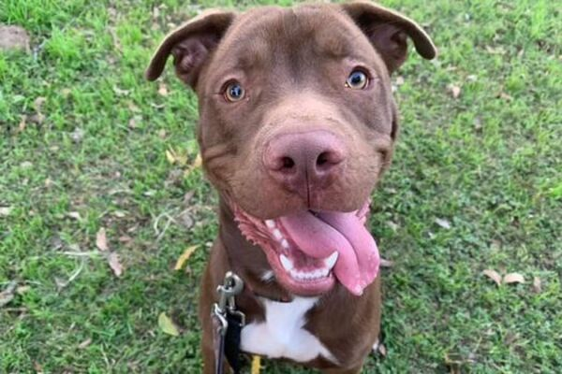
Questions?
https://www.austintexas.gov/austin-animal-center

